Slide 1
Capstone Engagement
Assessment, Analysis, and Hardening of a Vulnerable System

Slide 2
Table of Contents
This document contains the following sections:
01
Network Topology
02
Red Team: Security Assessment
03
Blue Team: Log Analysis and Attack Characterization
Hardening: Proposed Alarms and Mitigation Strategies
04

Slide 3
Network Topology
3

Slide 4
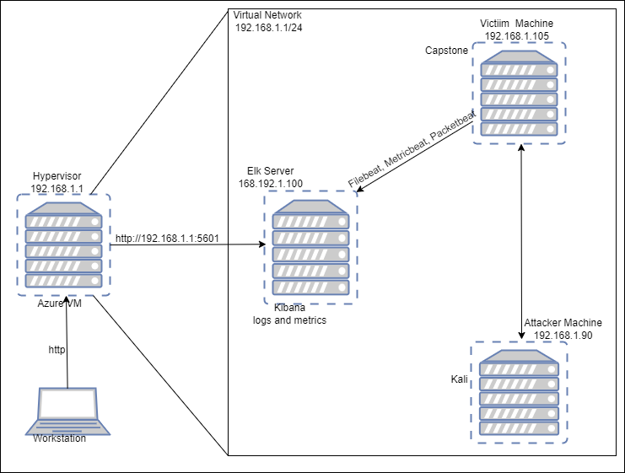
Network Topology
Network
Address Range:192.168.1.1 – 192.168.1.105
Netmask: 192.168.1.1/24
Gateway: 192.168.1.1
Machines
IPv4: 192.168.1.1
OS: Windows
Hostname: Hypervisor
IPv4: 192.168.1.90
OS: Linux
Hostname: Kali
IPv4: 192.168.1.100
OS: Linux
Hostname: Elk Server
IPv4: 192.168.1.105
OS: Linux
Hostname: Capstone

Slide 5

Red Team
Security Assessment
5

Slide 6
Recon: Describing the Target
Nmap identified the following hosts on the network:
Hostname | IP Address | Role on Network
Hypervisor | 192.168.1.1 | Gateway
Elk | 192.168.1.100 | Elastic Stack Server (Kibana logs and metrics)
Capstone | 192.168.1.105 | Victim
Kali | 192.168.1.90 | Attacker

Slide 7
Vulnerability Assessment
The assessment uncovered the following critical vulnerabilities in the target:
Vulnerability | Description | Impact
OpenSSH 7.7 CVE-2018-15473 | The vulnerability allows a remote attacker to enumerate all accounts on the system. The vulnerability exists due to a logical error in auth2-gss.c, auth2-hostbased.c, and auth2-pubkey.c files when processing authentication requests. | A remote attacker can send a specially crafted chain of packets and monitor behavior of openssh server to determine presence of a valid username. The server will drop connection upon receiving a malformed authentication packets if the username is valid.
Apache HTTP 2.4.37 and prior CVE-2018-17189 | In Apache HTTP server versions 2.4.37 and prior, by sending request bodies in a slow loris way to plain resources, the h2 stream for that request unnecessarily occupied a server thread cleaning up that incoming data. This affects only HTTP/2 (mod_http2) connections. | It crashes processes which could result in Denial of Service.

Slide 8
Exploitation: [Brute Force Vulnerability]
01
02
Tools & Processes
Nmap scan
dirb
Hydra
Achievements
Users login credentials
Access to hidden folders

Slide 9
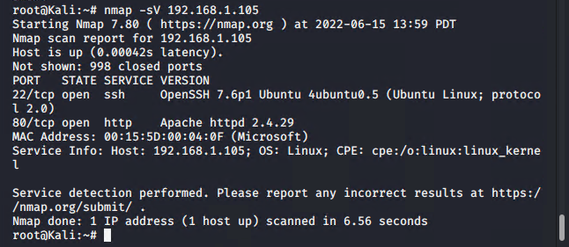
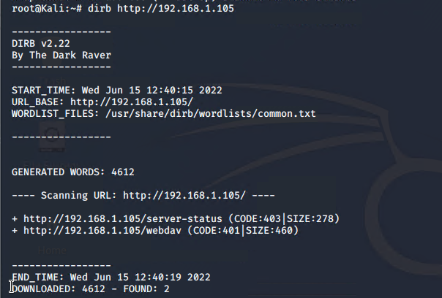
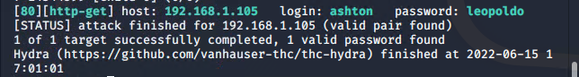

Slide 10
Exploitation: [Security misconfiguration]
01
02
Tools & Processes
Web Browser
Unauthenticated Http session open on the victim.
Achievements
Access to the webdav server and hidden folders and password file.

Slide 11
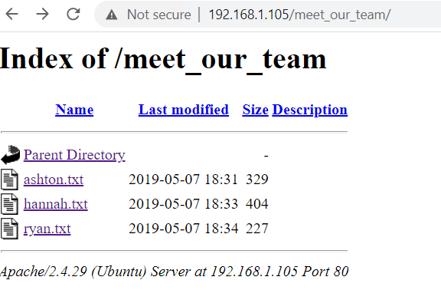
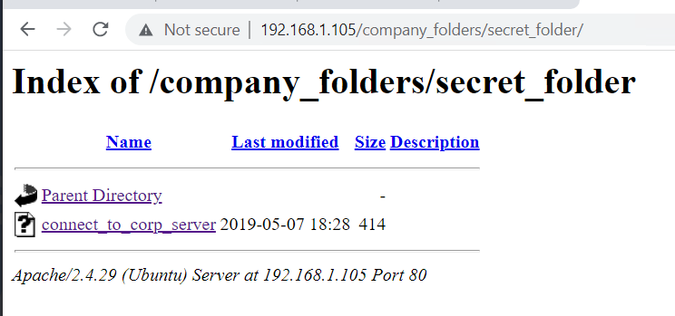
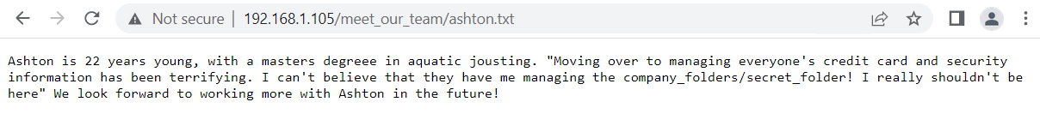
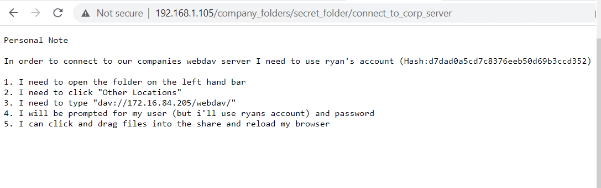

Slide 12
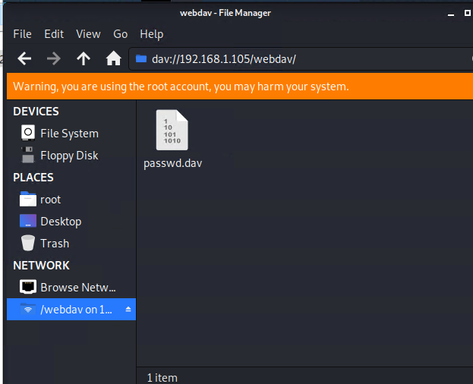
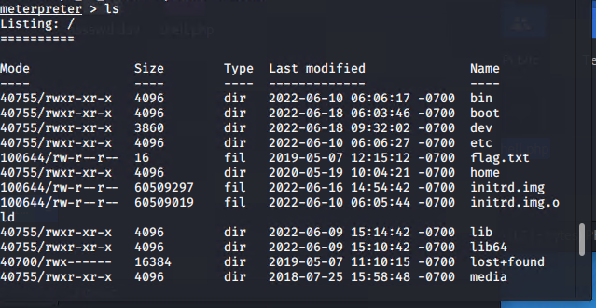
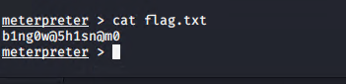

Slide 13
Exploitation: [Local File inclusion]
01
02
Tools & Processes
Msfvenom php payload
metasploit
User login credentials
Decryption
Achievements
Privilege escalation
Access to the webdav server.
Remote code execution

Slide 14
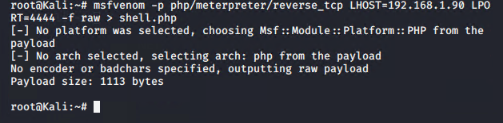
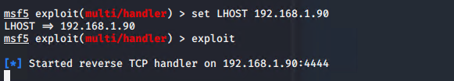
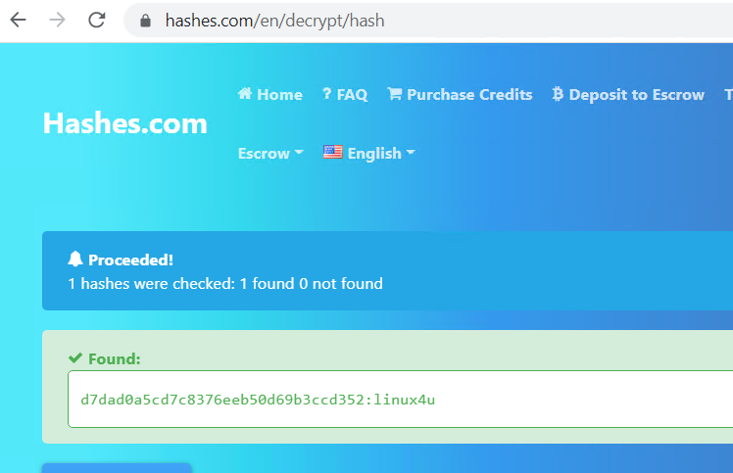
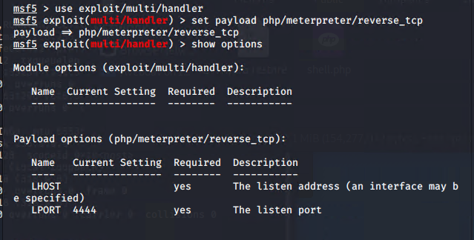
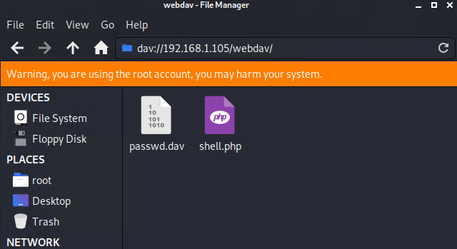

Slide 15

Blue Team
Log Analysis and Attack Characterization
15

Slide 16

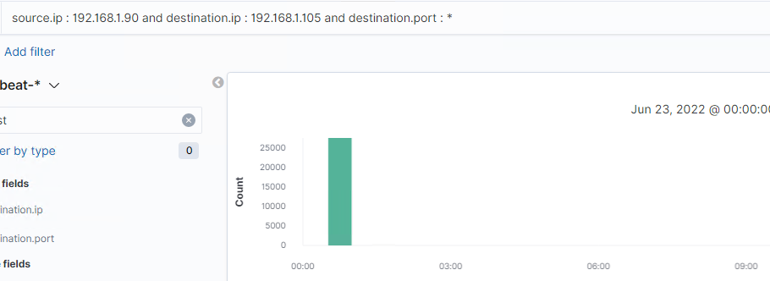
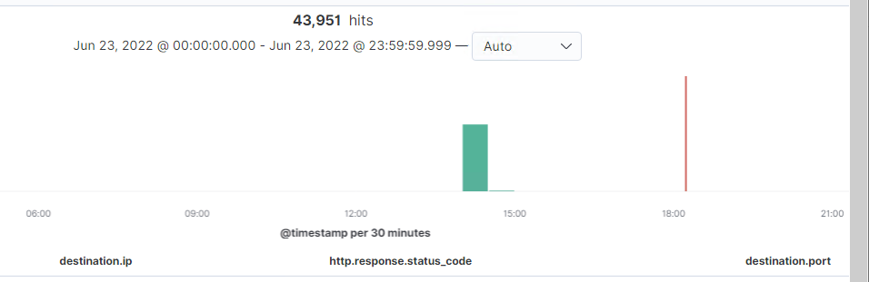
Analysis: Identifying the Port Scan
Answer the following questions in bullet points under the screenshot if space allows. Otherwise, add the answers to speaker notes.
What time did the port scan occur?
How many packets were sent, and from which IP?
What indicates that this was a port scan?
The port scan occur at 00:30 and 14:30.
43,951 packets were sent from 192.168.1.105
The high number of packets indicates that was a port scan.

Slide 17
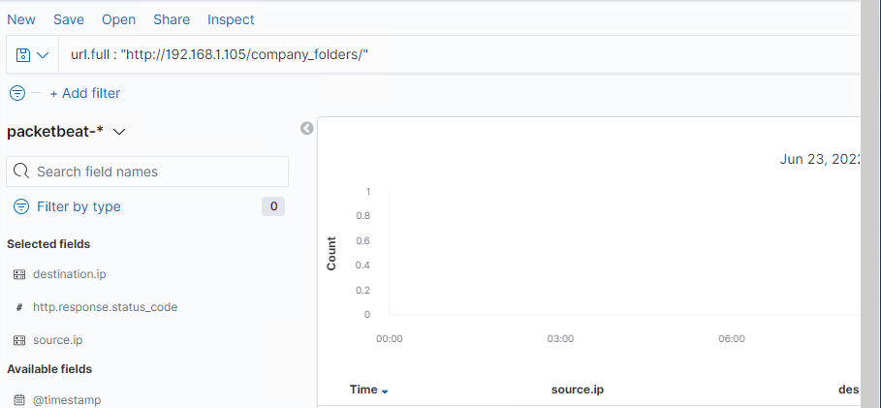
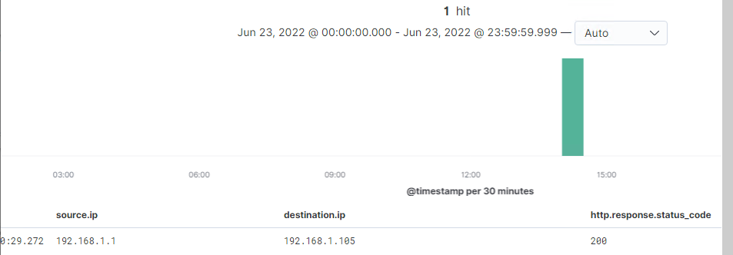
Analysis: Finding the Request for the Hidden Directory
Answer the following questions in bullet points under the screenshot if space allows. Otherwise, add the answers to speaker notes.
What time did the request occur? How many requests were made?
Which files were requested? What did they contain?
The request occurred at 14:30. And 1 request were made.
The secret_folder was requested. The folder contain the user Ryan password hashes and the path to reach the webdav server.

Slide 18
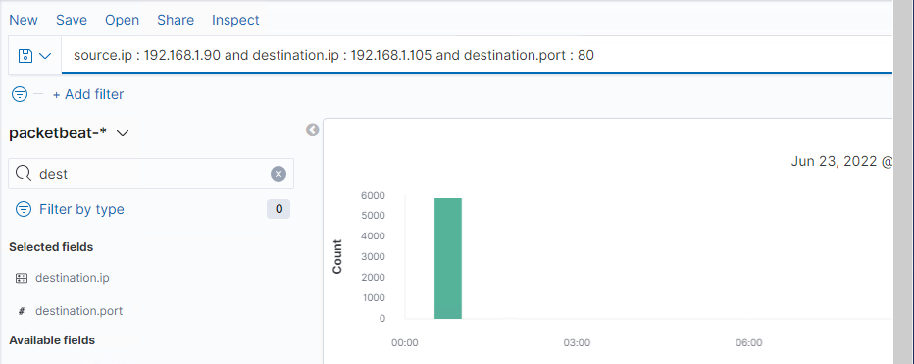
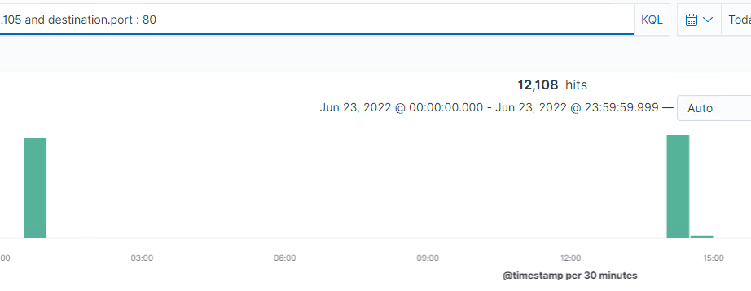
Analysis: Uncovering the Brute Force Attack
Answer the following questions in bullet points under the screenshot if space allows. Otherwise, add the answers to speaker notes.
How many requests were made in the attack?
How many requests had been made before the attacker discovered the password?
12,108 requests were made.
Almost 12,000 requests were made before the attacker discovered the password.

Slide 19
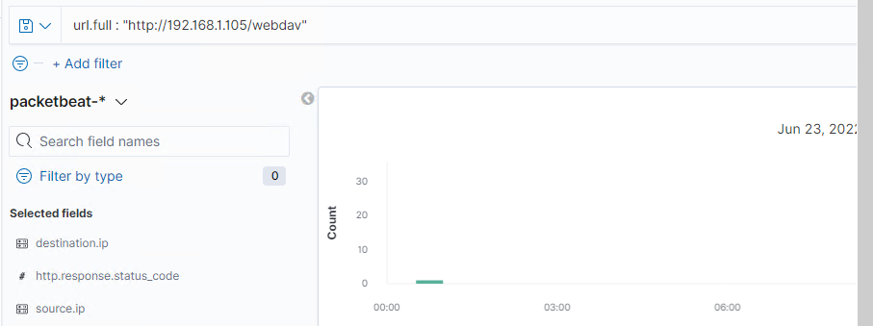
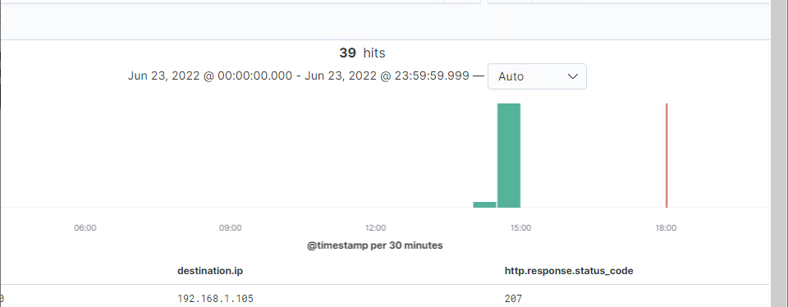
Analysis: Finding the WebDAV Connection
Answer the following questions in bullet points under the screenshot if space allows. Otherwise, add the answers to speaker notes.
How many requests were made to this directory?
Which files were requested?
58 requests were made to this directory.
The root user’s files were requested. The flag.txt file.

Slide 20
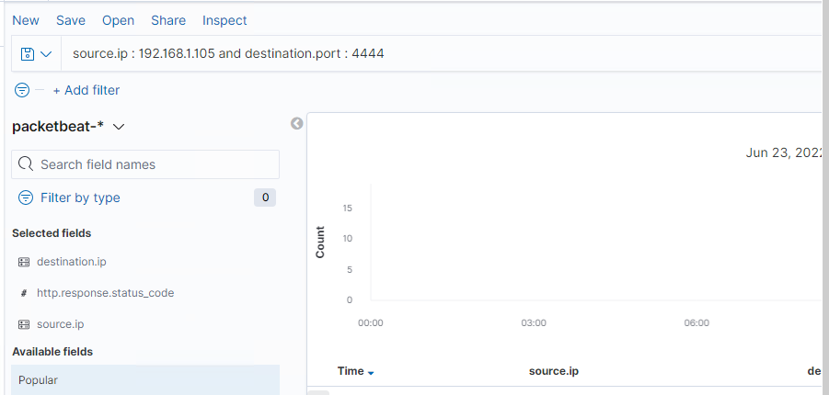
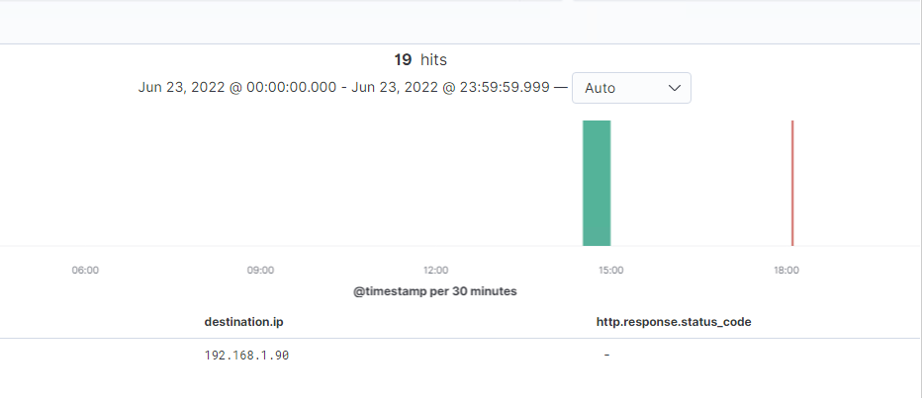

Slide 21
Blue Team
Proposed Alarms and Mitigation Strategies
21

Slide 22
Mitigation: Blocking the Port Scan
What kind of alarm can be set to detect future port scans?
Excessive http requests
What threshold would you set to activate this alarm?
WHEN sum() of ‘http.request.packets’ count OVER all documents IS ABOVE 5000 for the last 1 minute.
What configurations can be set on the host to mitigate port scans?
Intrusion Detection System rules on the Network.
Network scan and host sweep filter tools.
Host-based IDSs
Operating System guessing prevention.
Profile based detection system or Anomalies detection system alert.

Slide 23
Mitigation: Finding the Request for the Hidden Directory
What kind of alarm can be set to detect future unauthorized access?
Http Request Size Monitor
What threshold would you set to activate this alarm?
WHEN sum() of ‘http.request.bytes’ OVER all documents IS ABOVE 3500 bytes for the last 1 minute
What configuration can be set on the host to block unwanted access?
Use https, http over SSL/TLS.
Filter all http requests.
Set permissions on the web server directory.
File protection systems, such as encryption/decryption for access.
OSs file security monitoring such as Active Directory.
Server side input validation.

Slide 24
Mitigation: Preventing Brute Force Attacks
What kind of alarm can be set to detect future brute force attacks?
login error count.
What threshold would you set to activate this alarm?
WHEN sum() OF login error count for a user IS ABOVE 10 within 3mn.
What configuration can be set on the host to block brute force attacks?
Two factor authentication, using phone number, authentication Apps.
Use CAPTCHA to prevent automated login.
Set password complexity policy.
Use multiple login URLs.
Block unauthorized access to servers.

Slide 25
Mitigation: Detecting the WebDAV Connection
What kind of alarm can be set to detect future access to this directory?
Excessive http errors
What threshold would you set to activate this alarm?
WHEN count() GROUPED OVER top 5 'http.response.status_code' IS ABOVE 400 FOR THE LAST 5 minutes
What configuration can be set on the host to control access?
Two factor authentication for any login access to the server.
Periodic server software update for new patches.
Block URL redirection.

Slide 26
Mitigation: Identifying Reverse Shell Uploads
What kind of alarm can be set to detect future file uploads?
CPU usage monitor
What threshold would you set to activate this alarm?
WHEN max() OF system.process.cpu.total.pct OVER all documents IS ABOVE 0.5 FOR THE LAST 3 minutes.
What configuration can be set on the host to block file uploads?
Block unauthorized files uploading on the server.
File Integrity Monitoring solutions
Authenticate all remote connection to the webdav server.
Block unauthorized software or script to run on the server.
OS based firewall to block any code execution attempt on the server.
Logs endpoint events

